Slide 1
Personalized Public Displays
Design
Juan Camilo Garcia Henri Koski Yifei Zuo Haejong Dong

Slide 2
Table of contents
Motivation
Design process
State of the art
Personas & Scenarios
Requirements
Use case
System design
Evaluation & Prototypes
Risk assessment
Contributions

Slide 3
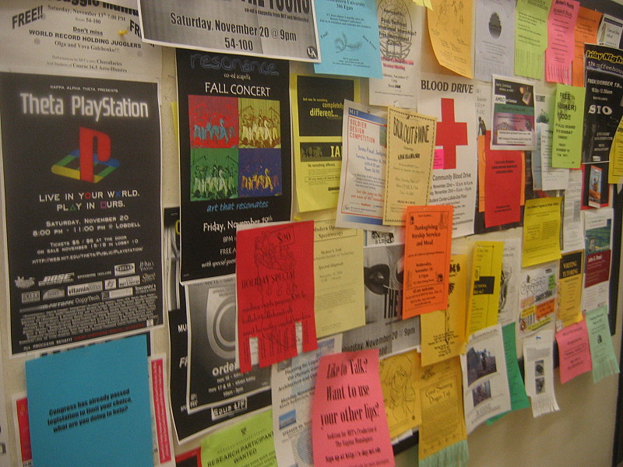
Motivation
Public displays' popularity has been increasing.
Most of the content is almost entirely non-interactive and consists of displaying announcements.
Bulletin boards are messy public spaces.
Notes:
Hard to find useful information
Hard to find changes
DIfficult to update changes

Slide 4
State of the art: Public displays
Civic engagement for young people
Crowdsourcing data or tasks
Broadcasting content via Bluetooth name
Tacita: Architecture to personalise displays
Notes:
Feedback to local government
Queue estimations
Micro tasks (as workstations)
More into our topic:
Personalise content: Google search, Youtube videos, songs, images, etc
Focused on security, how to communicate and find public displays

Slide 5

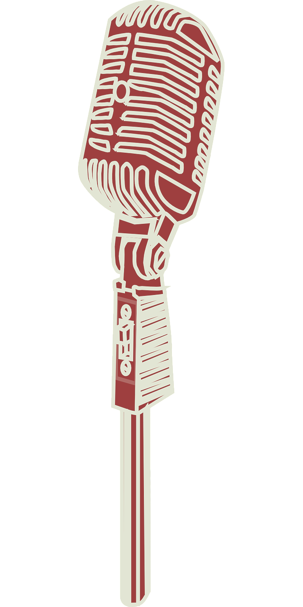

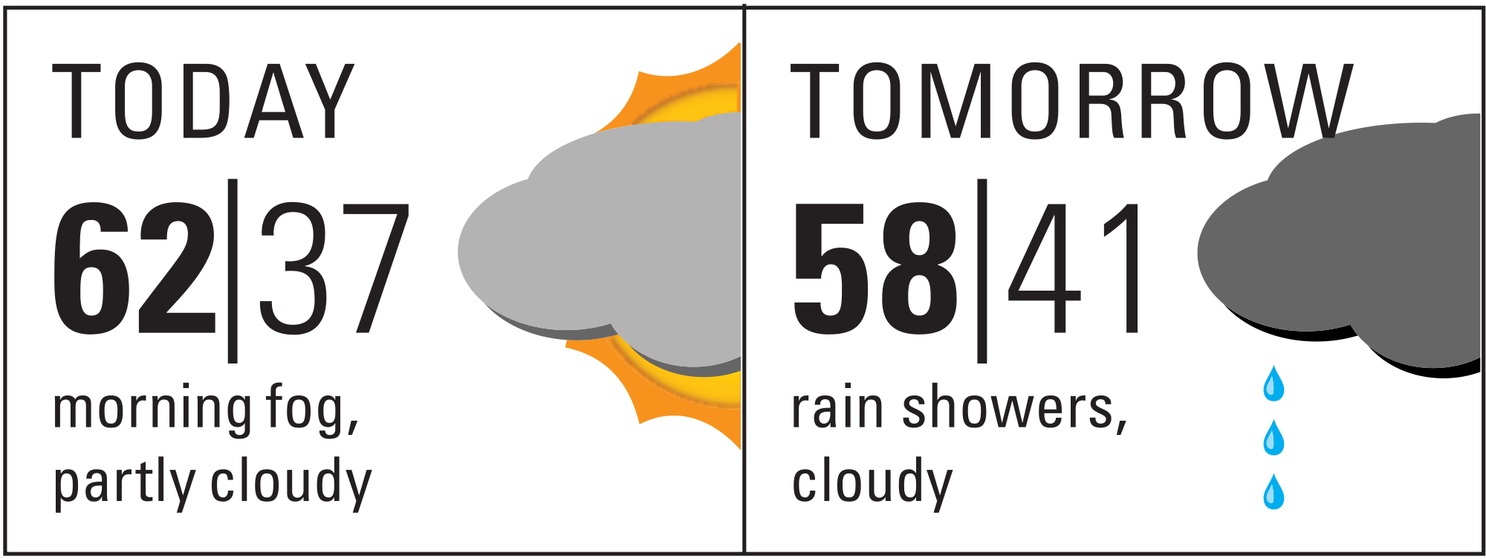
State of the art: Personalisation
Three types of personalisation levels:
Information that can be shown if no direct links to the source exist. Songs in a bar.
Information that must not be shown in the public. Medical records.
Information that can be shown in the public. Wind forecast in favorite city to kite surf.
Reminder display and News display
Actionable content
Non-actionable content
Notes:
News non-actionable
Reminder actionable
Actionable has deadline and incites people to act
Discount, exam registration…
Non-actionable has no deadline and no action
Normal news or announcements

Slide 6
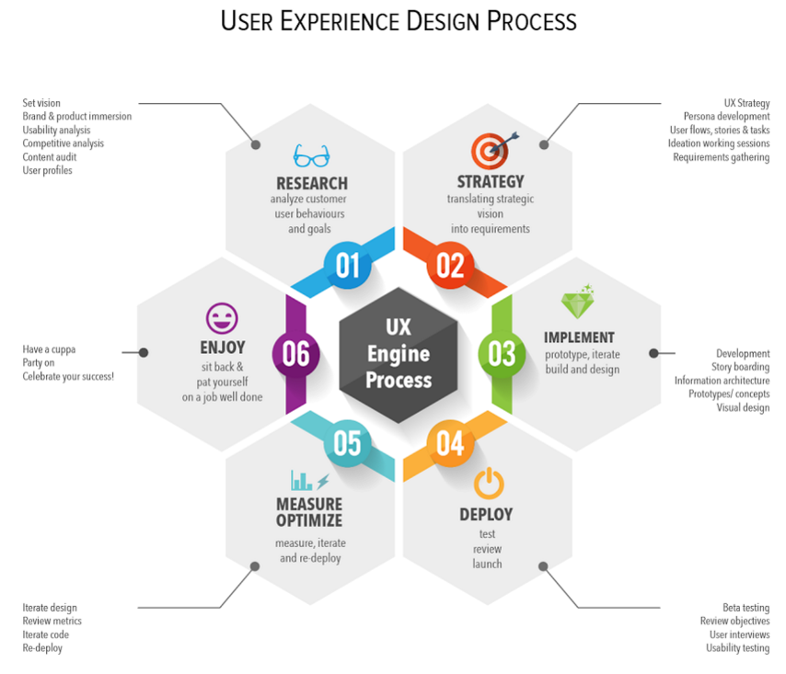
Design process
Research
Brainstorming ideas
identify capacity of the given devices
Idea decision
identify stakeholders
identify usability
identify viability
identify needs
Literature review
study similar systems
Specify goals and features
what are the requirements?

Slide 7
Design process
Strategy
Clarify requirements
categorize requirements
Identify possible issues
privacy issue
technical issue
reported issues from similar systems
Suggest solutions
solutions to proposed issues

Slide 8
Design process
Implement
Initial prototyping
hand-drawn wireframe for mobile system
hand-drawn wireframe for display system
Drawing system architecture
Create high-fidelity wireframe
using HTML/CSS, Powerpoint or other variety of tools

Slide 9
Personas & Scenarios
Student Esa Kokkoniemi
30 year old
Has expertise in general computer system
Has least experience in Android application
First time use the system
Looking for a job offer
Student Olli Saarela
20 year old
Has general experience only to deal with mobile application
First time use the system
Need to be reminded about his courses

Slide 10
Personas & Scenarios
Student Charlie
25 year old
Has general experience in computer system
Has used the system a few times
Looking for a job offer
Looking for a lecture room

Slide 11
Requirements
Statement of needs
Student 1: looking for a lecture room for his/her course
navigator (on mobile) that directs him/her to the rough direction of the lecture room
navigation (on display) that comes with an indoor map of the university and with a marker at the location of the room
Student 2: looking for information
provided personalized information in a form of bulletin boards in the university campus such as job offer
provided recommendations for public events and other useful information that are underlying his/her interest such as schedule reminder as well as general information above.

Slide 12
Requirements
Functional / non-functional requirements
This will specify general requirements enumerated in SON by categorizing into mobile system and display system;
on mobile system
users shall be able to find history of opened contents
users shall be able to see details of contents chosen on the display …
on display system
system shall be able to detect users nearby
users shall be able to find direction of the lecture room that she/he is heading to

Slide 13
Requirements
Privacy requirements
The information we intend to display is untenable with regard to privacy revelation, therefore we have added some of the additional requirements to ensure violation in revealing personal data against user agreement that are such as;
users configure sharing in sensitive data (social media, calendar etc.)
personal data on the display will fade off as the user leaves the place
users configure in which displays he/she would NOT like to involve to show the data

Slide 14
Requirements
Interface requirements
As the system is used in a busy area, it needs to have such attractive design to motivate users stop and interact with.
mobile design
display design
aimed to be intuitive so that passersby recognize that the system is a responsive

Slide 15
Requirements
Usability requirements
As the respective devices performs as a whole within the system, each system needs to be instructive.
providing guidance on the mobile at the first time use
pop-up window that implies the display could perform with the mobile application

Slide 16
Requirements
Performance requirements
For the better user experience, server needs to be up to date with the latest data from mobile users

Slide 17
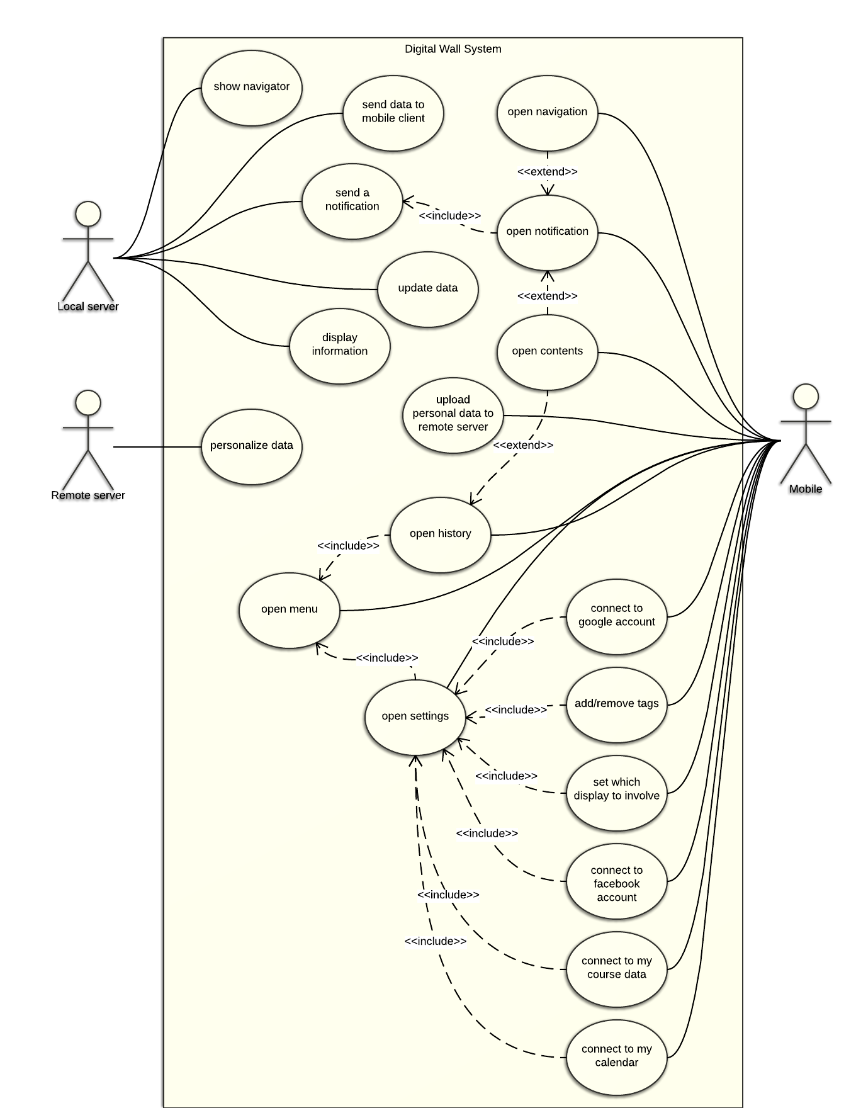
Use case
Local server
Main functionalities
display personalized information
detect mobile clients nearby
communication mobile clients nearby
show “navigator”

Slide 18
Use case
Remote server
Main functionalities
display personalized information
detect mobile clients nearby
communication mobile clients nearby
show “navigator”
Main functionalities
data personalize
send data to the local servers

Slide 19
Use case
mobile
Main functionalities
show contents sent from display
configure settings for data provision to the server
show history of contents
show “navigation” to the lecture room

Slide 20
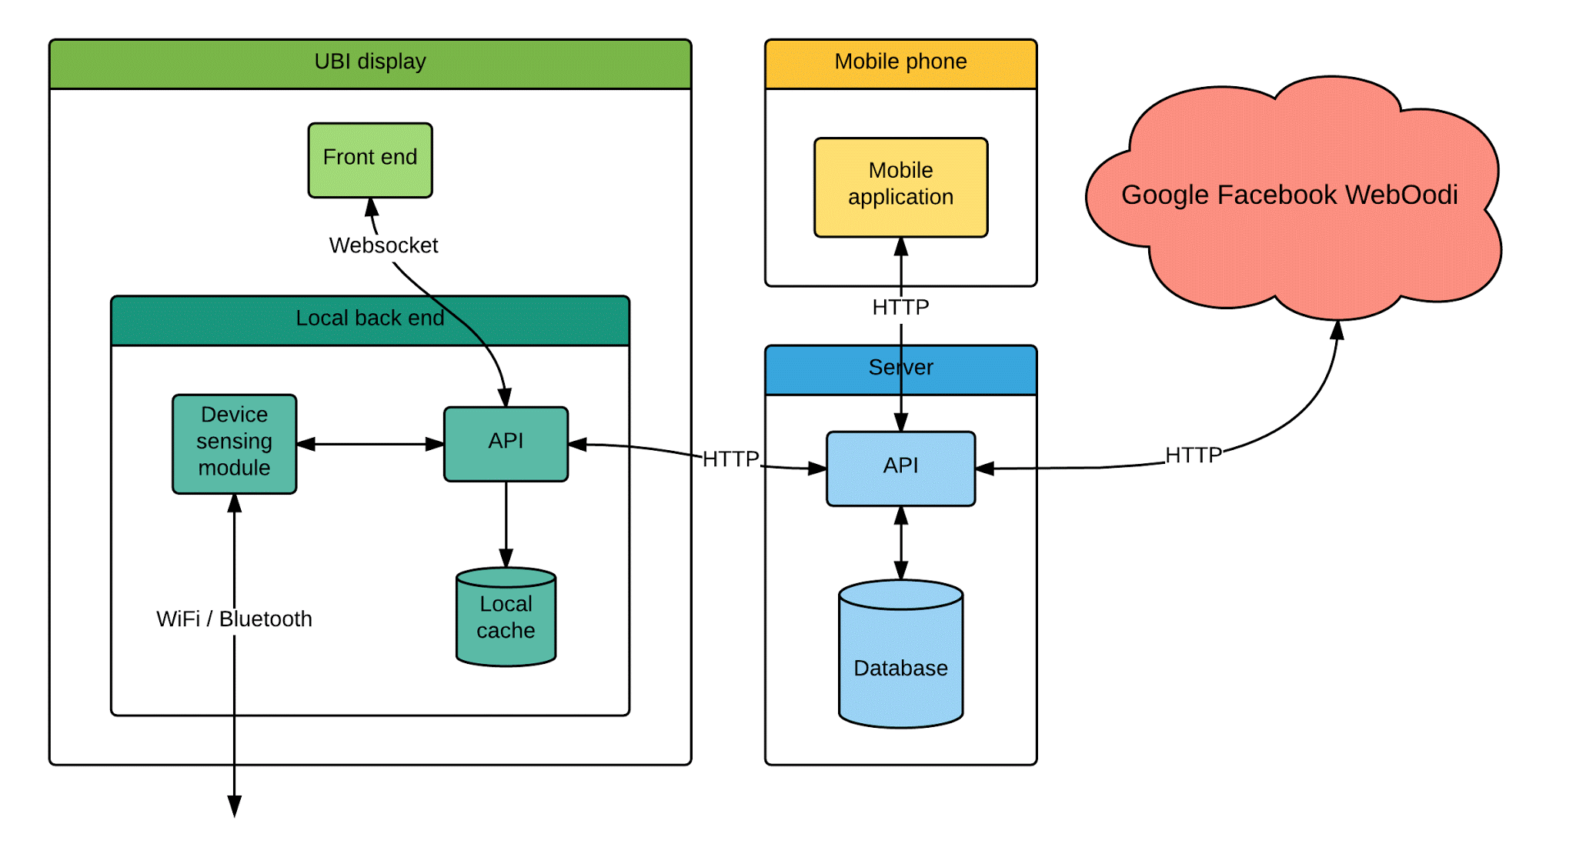
System design
Notes:
Security:
TLS/SSL for all HTTP connections
Token based authentication between UBI display and main server
Credential based authentication from mobile to main server
API key authentication for external APIs

Slide 21
Evaluation
10 Heuristics
• Visibility of system status
• Match between system and the real world
• User control and freedom
• Consistency and standards
• Error prevention
• Recognition rather than recall
• Flexibility and efficiency of use
• Aesthetic and minimalist design
• Help users recognize, diagnose, recover from error
• Help and documentation
Notes:
User control
Match to the real world
Efficiency of use
Aesthetic

Slide 22
Evaluation
Heuristics evaluation
Methods:
recruit participants
provide them 10 Heuristics to regard with
provide them a list of goals to achieve
observe participants and write down comments
provide a sheet of questionnaire to fill up
collect general opinions
Think-aloud protocol
Methods:
recruit participants
provide them a list of tasks to perform
observe and write down comments and answer the questions if has
provide a sheet of questionnaire to fill up
collect general opinions
Notes:
List of goals
Let them solve the problem themselves
Answer questions they have

Slide 23
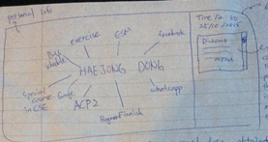
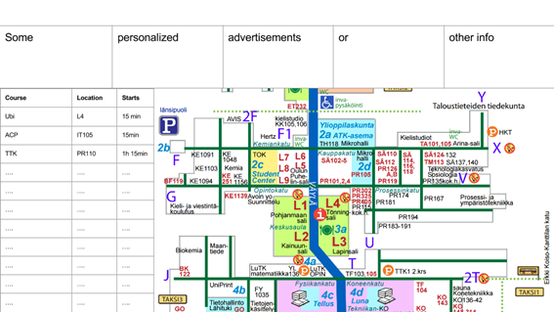
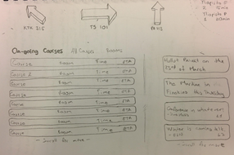
Wireframes
Notes:
Graph: Too personal content for a public space.
Map: Too less content focused only on navigation left not much room for more personalisation.
Last: Personalisation for groups and visualisations from users form far.
Last: Most of the screen was still focused on navigation.
We then tried to make new designs based on this ideas and reflexions.

Slide 24
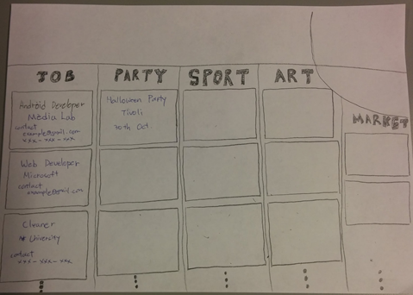
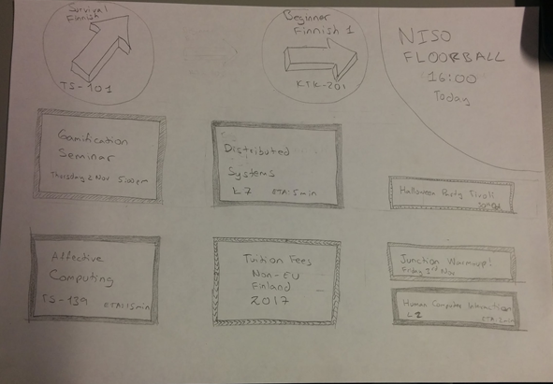
Sketches
Notes:
People liked the bubble
People liked titles but color coded content
They liked the navigation bar on the top
Bulletin boards had a similar idea, so we made some research on them and continued as a personalised digital bulletin board.
Event recomendations

Slide 25
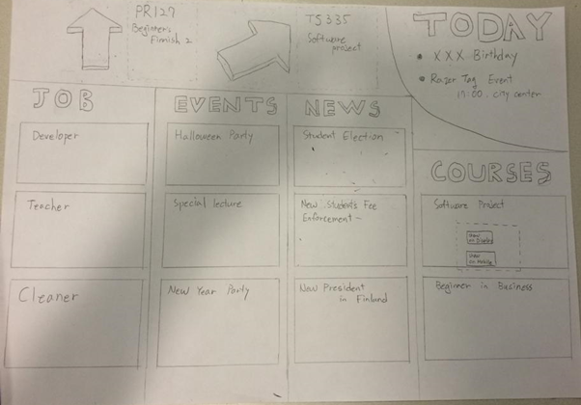
Paper prototypes: Public displays
Notes:
Initial interaction: tap (We didn’t entice tapping by text but by animation)
Arrows were maybe ambiguous -> They will be 3D arrows that are interactive.
First glance: top either the arrows or the top right bubble or the center -> animation will be specially on the arrows and bubble, but also on content that changes.
They want to decide which displays should be personalised (ex. city center vs. university).

Slide 26
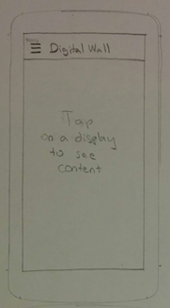
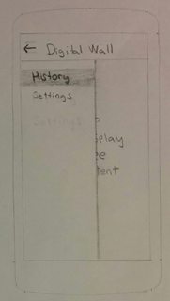
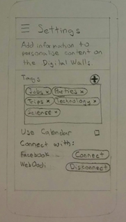
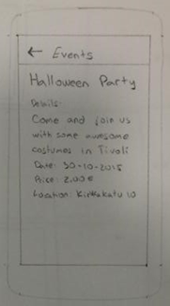
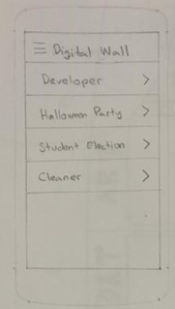
Paper prototype: Mobile application
First Home Screen
Menu
Settings Screen
Event from display
Home Screen
Notes:
Menu screen was unnecessary Navigation didn’t seem intuitive
Use calendar not clear

Slide 27
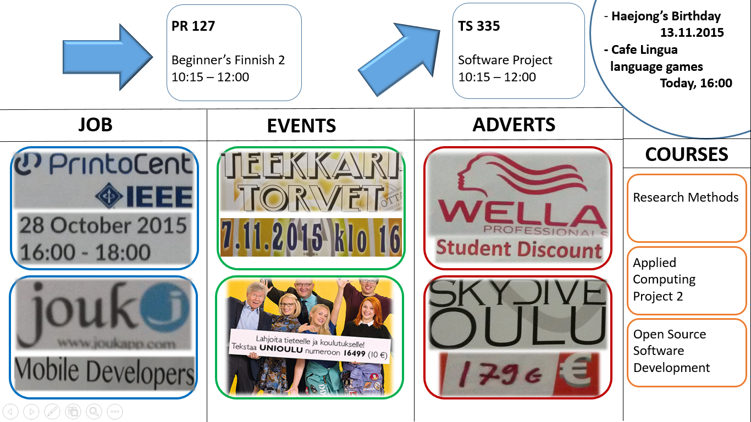
High fidelity prototype: Public display
Notes:
Content is color coded and has a specific title

Slide 28
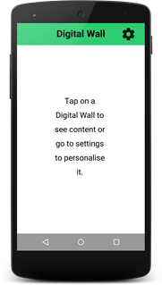
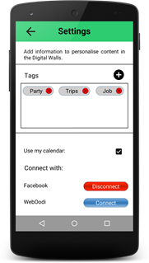
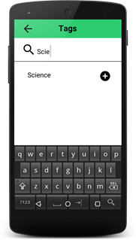
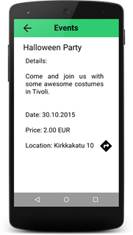
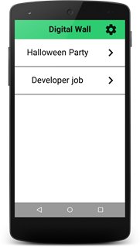
High fidelity prototype: Smartphone application
First Home Screen
Settings Screen
Add Tags Screen
Event from display
Home Screen
Notes:
Removed Menu
Added settings icon
Changed text of calendar

Slide 29
Risk assessment
Schedule flaws
For some parts of the project it’s hard to make accurate time estimations
Likely to happen but fairly easy to prevent with realistic goals
Communication problems
Too little communication inside group / with TA
Not that likely to happen when PM organizes regular meeting
Technical risks
Choosing technologies that the group is not familiar with
Technical difficulties with hardware
Likely to happen in some scale but can be prevented with thorough background work

Slide 30
Contributions
Name | Contribution | Hours
Haejong Dong | Design, Prototype, Evaluation, Report Writing | 62
Juan Camilo García | Design, Prototype, Evaluation, Report Writing | 52
Henri Koski | Evaluation, Report Writing, System Design | 19
Yifei Zuo | Design, Prototype | 14
Simo Hosio | Feedback | N/A

Slide 31
Thank you for your time

